Slide 1
Welcome, <client>!
AI For Leaders

Slide 2

Meet General Assembly
We empower people to do work they love through education in technology, data, and design.

Slide 3



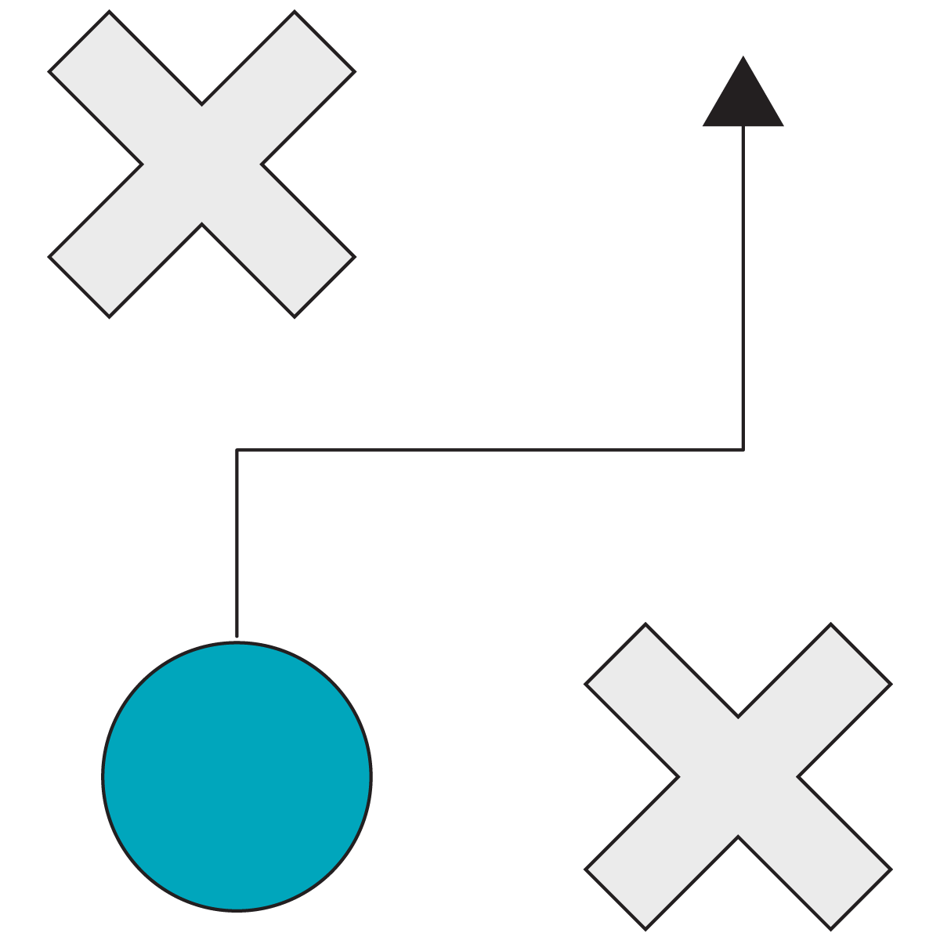


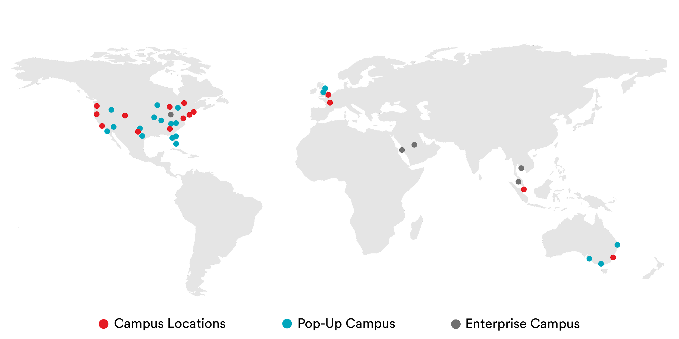
Who we are and what we do?
General Assembly
Accelerate Digital Transformation Through Enabling Talent
Digital Fluency
Engineering & Technology
General Assembly is a global upskilling and reskilling company with unmatched scale. Our programs enable teams to grow, compete, and thrive in the digital economy.
Marketing
Product Management
Data & AI
UX & Visual Design
400 clients including 35 Fortune 100 companies.
50,000 employees trained in 80 cities.
1,500 instructors and 20,000 in-network experts.
78,000 course alumni across 33 campuses.
10,000 live online learners in 5 years of remote delivery.
Fast Facts
General Assembly is a brand of the Adecco Group, the world's foremost provider of staffing, career transition, and talent development solutions.
Notes:
You all have heard about GA before and that we are part of the Adecco Group, but let me tell you a little more about who we actually are.
We are your colleagues, a global team of individuals who are extremely passionate about helping other individuals achieve their career aspirations,
and in particular, teach those individuals the most in-demand digital and tech skills.
We work with many Fortune 500 clients, powering their upskilling and reskilling academies to enable people grow, compete, and be successful in the digital world.
The key areas that we help enable are Digital Fluency (and Digital Foundations programme forms part of this capability), but also more function or role-specific training like Marketing, Technology, Data, Product and UX. And we help people achieve their learning goals offering learning journeys that target their specific growth needs.. Some fast facts about us:
We have helped over 400 clients including 35 Fortune 100 companies.
We have trained over 50,000 employees in 80 cities around the globe.
Our instructor network is made up of 1,500 instructors and 20,000 in-network experts.
78,000 course alumni across 33 campuses.
10,000 online learners in 5 years of remote delivery.

Slide 4
About Your Program
What?
In this one-day workshop, leaders will gain fluency in AI, including how it works and its ethical implications, in order to identify opportunities to incorporate AI in their organization.
We look forward to seeing you there!
When?
<add dates / times>
Where?
<add location>

Slide 5



AI For Leaders
Instructor-Led
Onsite or Remote
~7 Hours
Program Overview
The What, How, and Why of AI 1.75 hours | Articulate what AI is and the process by which AI is created, applied, and managed.
Choosing AI Projects 2 hours | Determine the projects or problems that would benefit the most from an AI solution.
Responsible AI 0.75 hours | Proactively identify the ethical, security, and privacy risks that may arise when integrating AI.
AI in the Organization 1 hour | Determine the key conditions needed for an AI project to be implemented successfully in your organization.
Opening, Wrap Up 1 hour
Overview:
Leaders will gain fluency in AI, including how it works and its ethical implications, in order to identify opportunities to incorporate AI in their organization.
Learner Audience:
Translators and Domain Decision-Makers (e.g., Product Managers / Owners, Business Managers / Strategists, Analysts, Subject Matter Experts).
Business Outcomes:
Conceptualize where AI can be a value-add to their business.
Weigh ethical considerations against business goals when developing AI solutions.
Identify and scope AI projects that add real business value to the organization.

Slide 6
Meet Your Instructor
CSM to complete
Add their face
Name
Title
Add
Their
Bio

Slide 7
Meet Your Instructor
CSM to complete
Add their face
Name
Title
Add
Their
Bio

Slide 8
Appendix
CSM can pull in additional slides as necessary

Slide 9

Your Virtual Classroom
Get set up with Zoom!
We will be using Zoom for our Live Online sessions. Be sure to download and test Zoom by <date>! The specific Zoom meeting link will be included in your calendar invite for our session.
You will join Zoom via your computer so that you can use the video functionality of the meeting for our virtual classroom. Download and test zoom by going to http://zoom.us/test. This will take you through joining Zoom on your computer and prompt you to download Zoom to your computer if you have not done so already. More in-depth instructions for testing can be found here.
When joining the Live Online classroom via Zoom, turn your video on as it will be an interactive session!

Slide 10

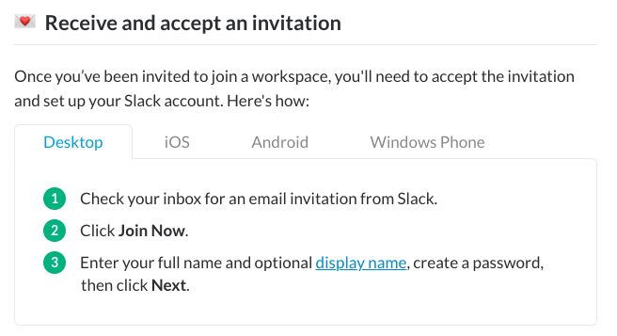
Your Virtual Classroom
Get set up with Slack!
Slack is a collaboration tool used in many enterprises and is central to GA’s Live Online learning experience. We use Slack to answer questions, poll the group, share updates, and to create a direct link between participants and instructors.
You will receive an invitation via email from General Assembly to join the program workspace.

Slide 11

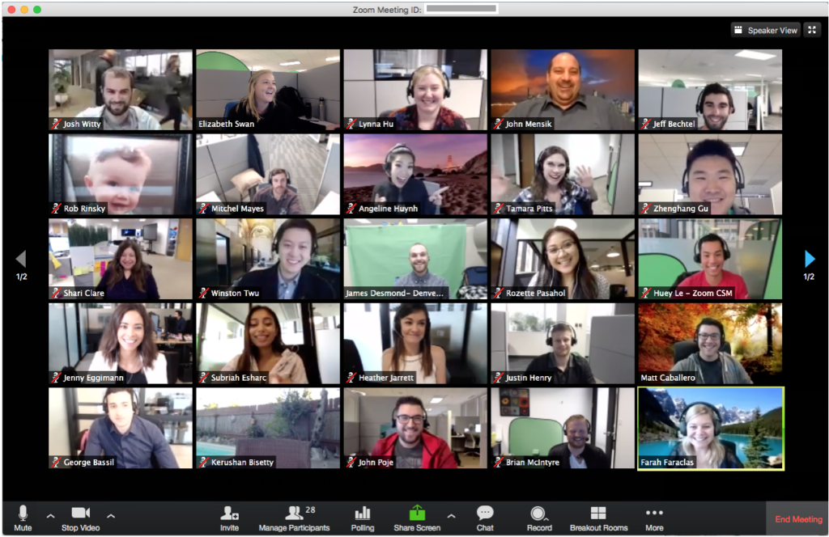
Your Virtual Classroom
To get the most of these sessions, we ask that you:
Check that your microphone and video camera are enabled. Video is the next best thing to face-to-face communication. We want to see your faces, and hear your voices!
Actively participate! This is not a webinar, but an interactive experience with team activities and open discussion.
Plan to be present. Avoid scheduling meetings during sessions, put up an “away” message for any chat apps, and/or prepare an automatic email reply to inform colleagues of delayed responses.

